Slide 1
FANTASY CRICKET APPLICATION
Guided By,
Mrs. G. Priyanka, AP(Sl.Gr.)
Dr. N.Kavitha, AP(Sr.Gr.)
Department of CSE
Manoj M – 9517202304254
Pothiraju P V – 9517202304112
Siva Prakash S – 9517202304156

Slide 2
AGENDA
Problem Statement
Objective
Outcome
System Design
UML Diagrams
Implementation Results / Screenshots
Platform and Languages
References
Demo

Slide 3
Problem Statement
A fantasy cricket application with a live scoring system for domestic cricket faces the challenge of providing real-time updates while enabling users to create and manage custom teams. The system must ensure accurate and fast live score updates while integrating seamlessly with fantasy features like team performance tracking, leaderboards, and point calculations. This creates an engaging and immersive experience for users, especially in the context of domestic cricket, where tailored coverage and interactive features are key to attracting and retaining a dedicated audience.

Slide 4
Objectives
➢Real-time ball-by-ball scoring
➢Comprehensive match-player statistics
➢Fantasy team creation and management
➢Live leaderboard updates
➢Detailed match summaries
➢Multi-user access control
➢Data persistence and validation

Slide 5
Outcomes
Fantasy cricket for Domestic cricket
Live Score for domestic matches
Proper Cricket logics for local matches
Persistant Team details management
Visual Representation of match-performance
Effcient Scouting

Slide 6
System Diagram
Fantasy Cricket Application
View Matches
LIve Matches
Completed Matches
Upcoming Matches
Create Matches
Quick Match
Scheduled Matches
Manage Team
Add Team
View TeamDetails
Update Team
Add Players
Fantasy Section
Fantasy Creations
Fantasy team view
LIve-Score Update
Match Stats
Comments Page
Fantasy Leaderboard

Slide 7
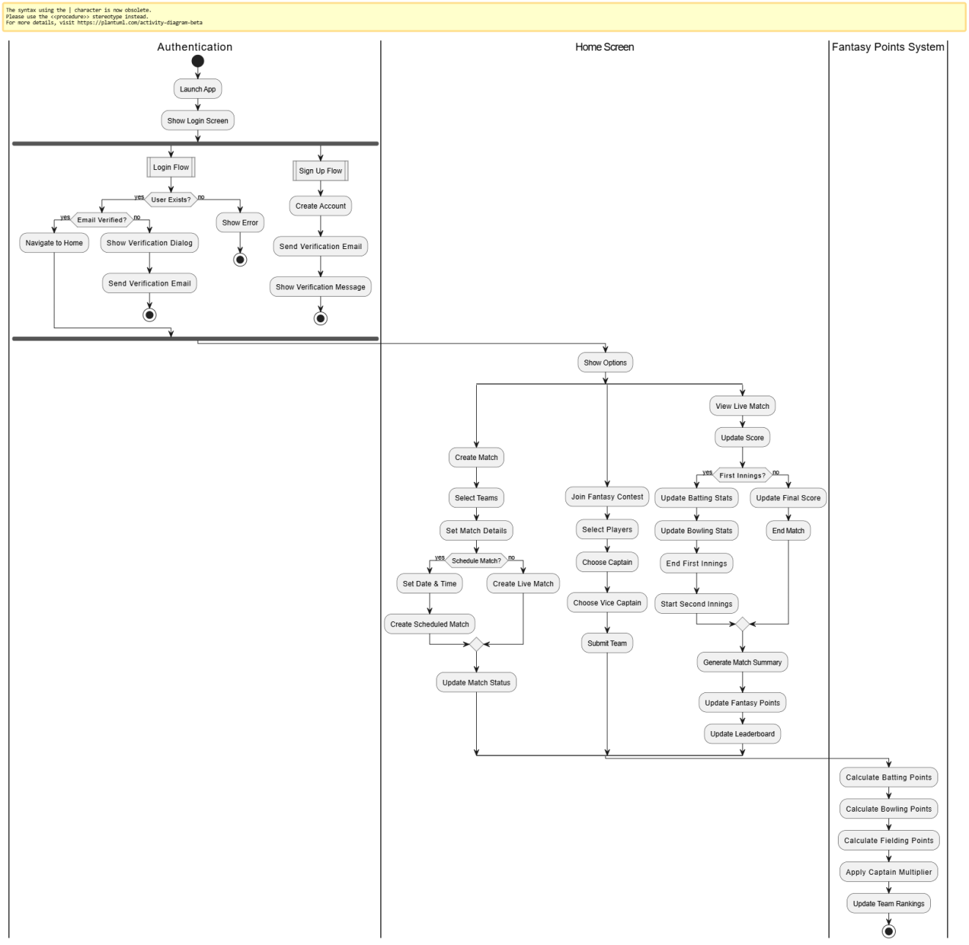
UML Diagrams - Activity Diagram

Slide 8
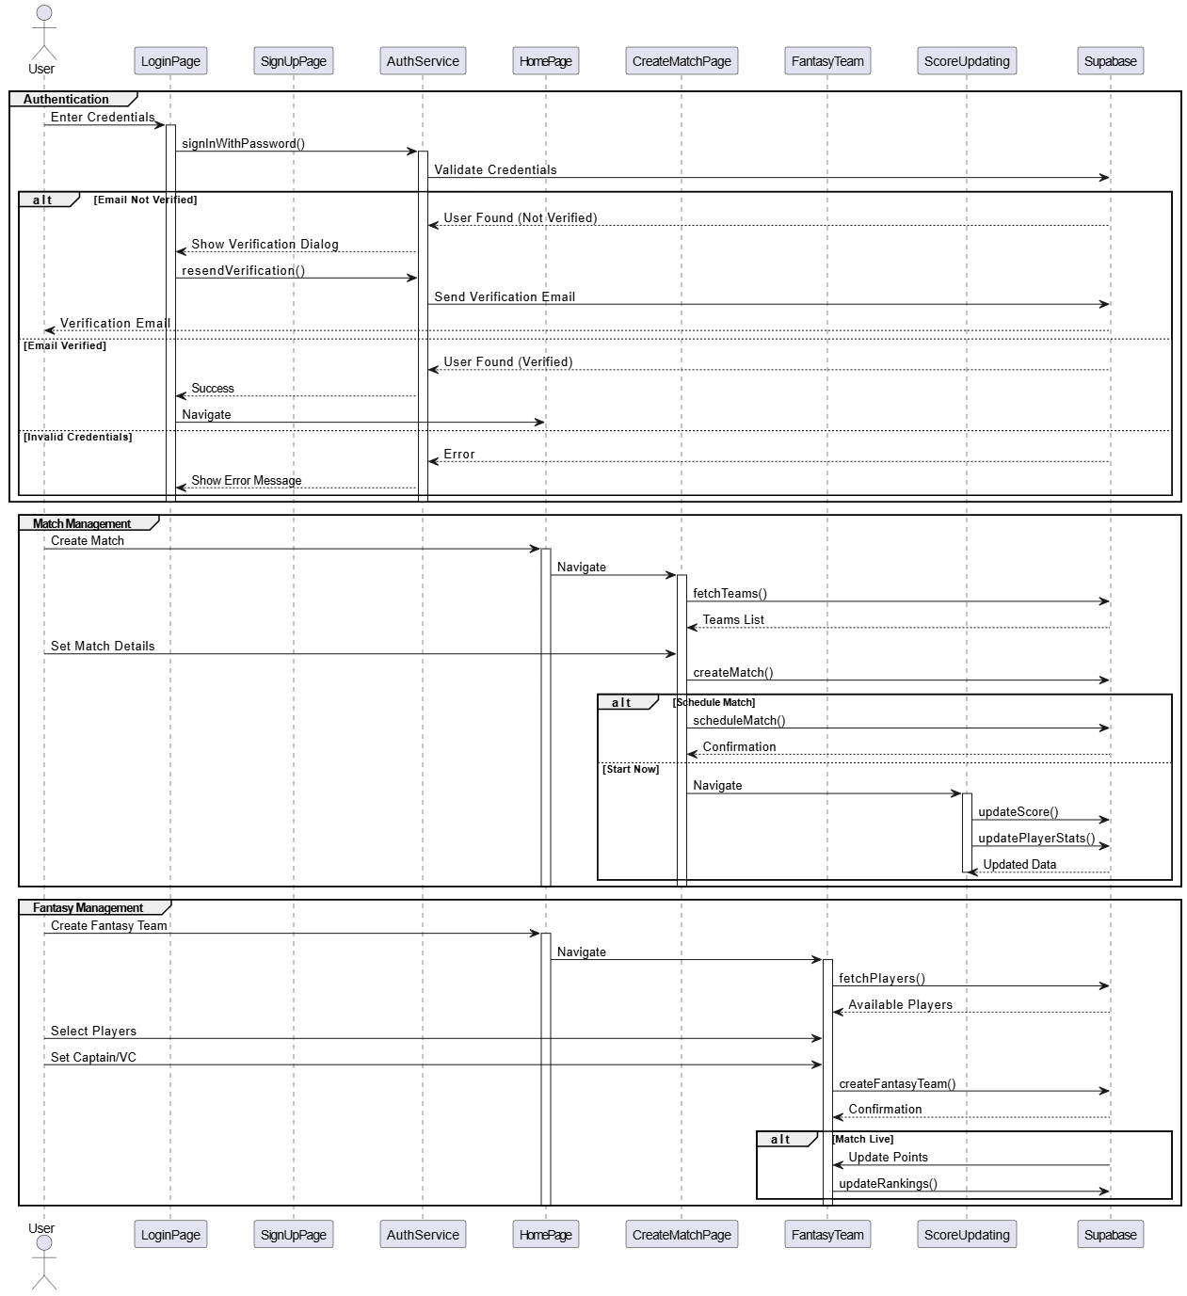
Sequence Diagram

Slide 9
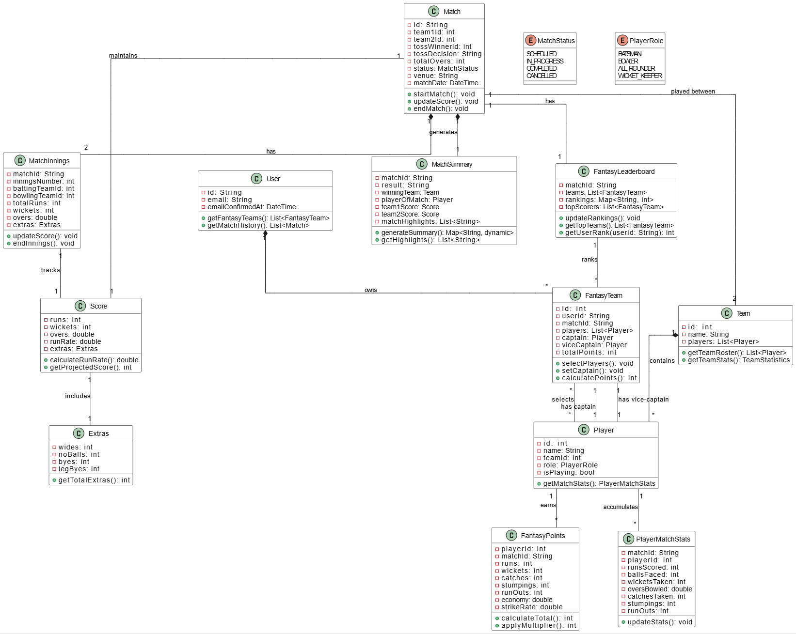
Class Diagram

Slide 10
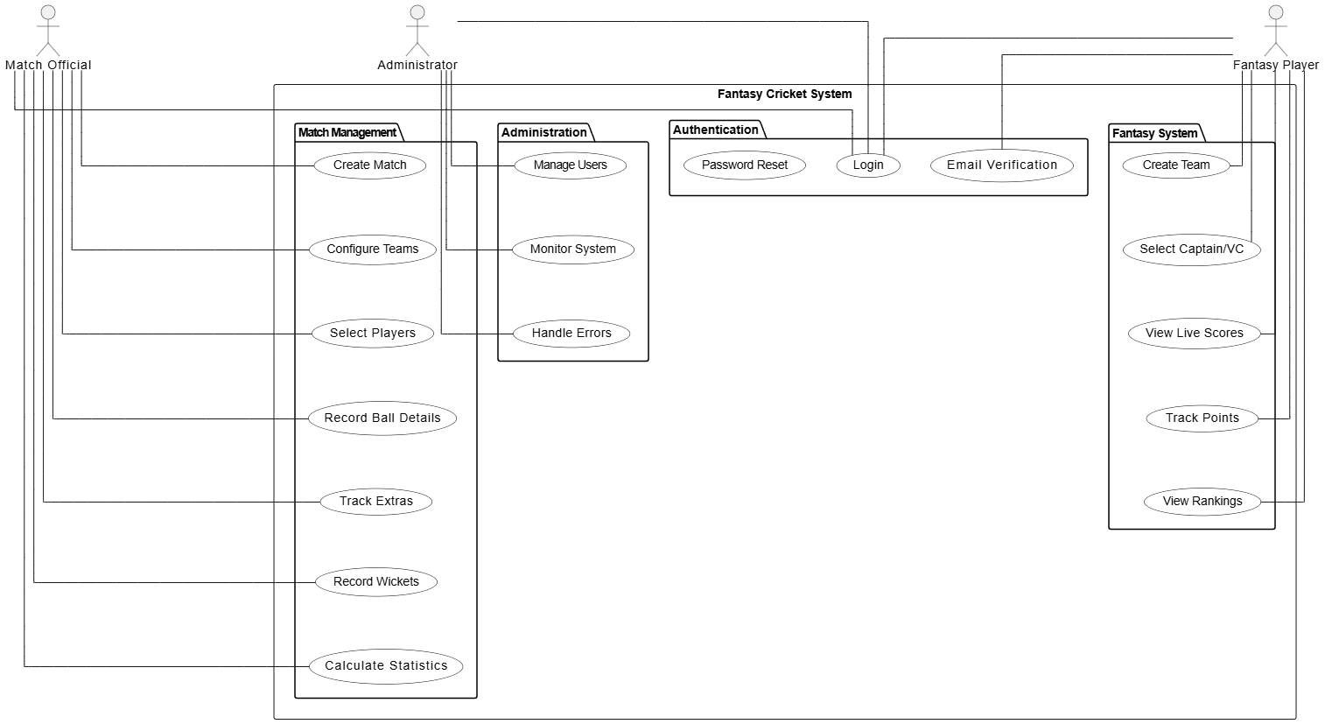
Use Case Diagram

Slide 11
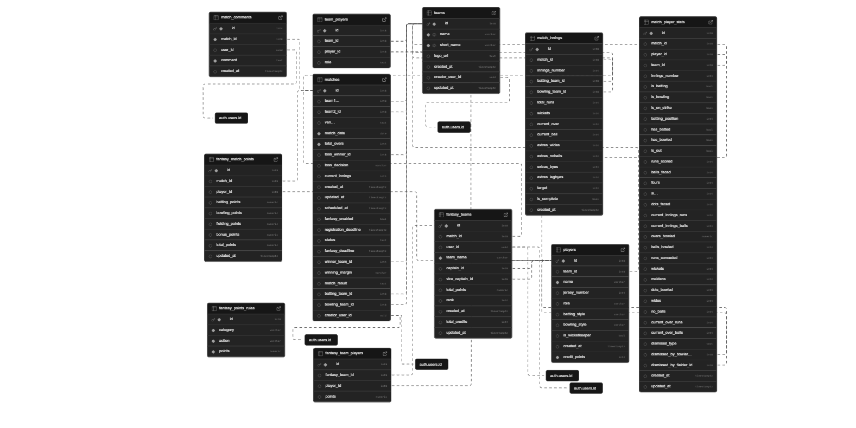
Schema Diagram

Slide 12
Platforms and Languages
Platform :
Frontend: Flutter (Cross-platform framework for Web, and Desktop)
Backend: Supabase (A Backend-as-a-Service platform with database, authentication, and API features)
Languages :
Frontend - Dart
Backend - PostgreSQL by Supabase
Services :
Authentication - Supabase
Environment :
VS Code - Use Flutter and Dart extensions for development.
Supabase Dashboard: For managing your backend services.

Slide 13
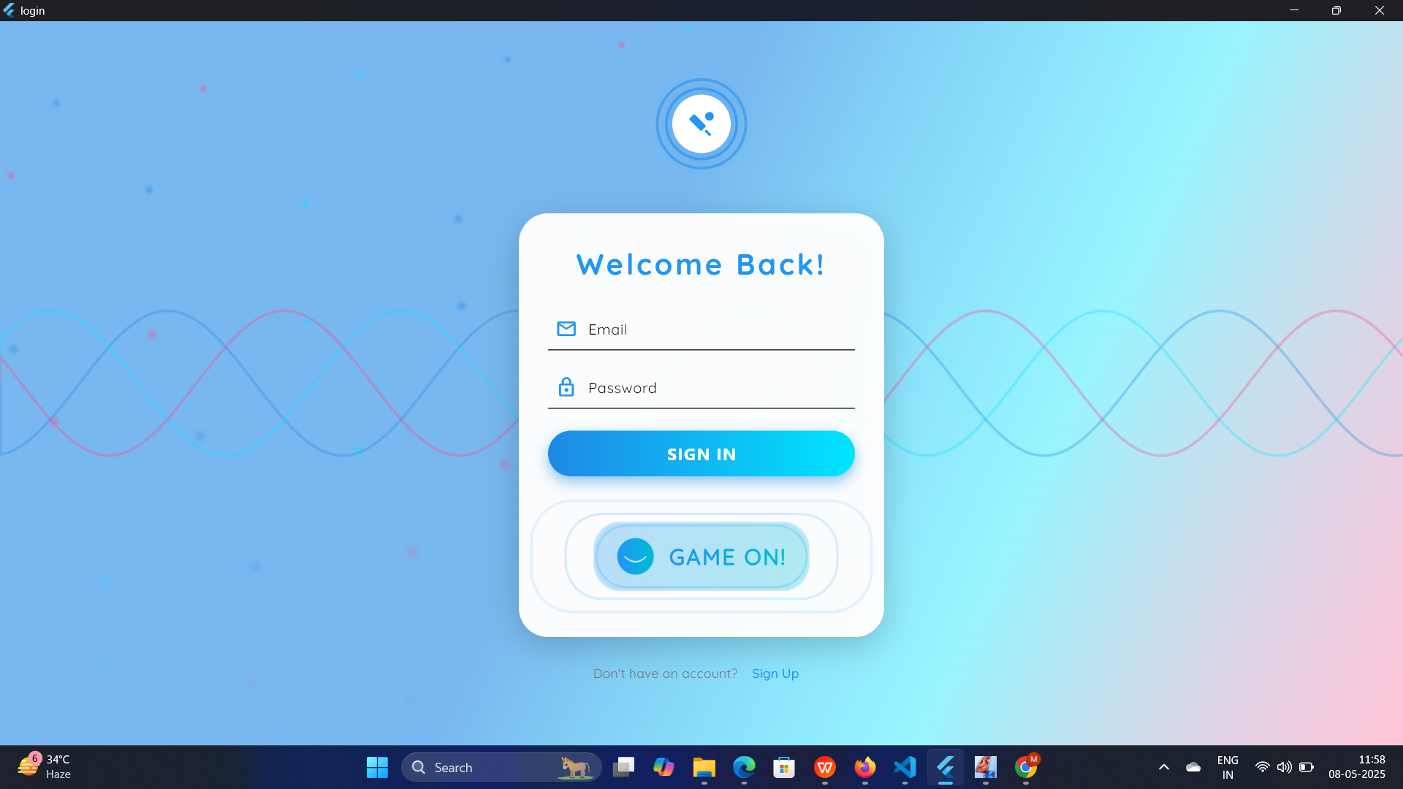
Implementation Results - Login

Slide 14
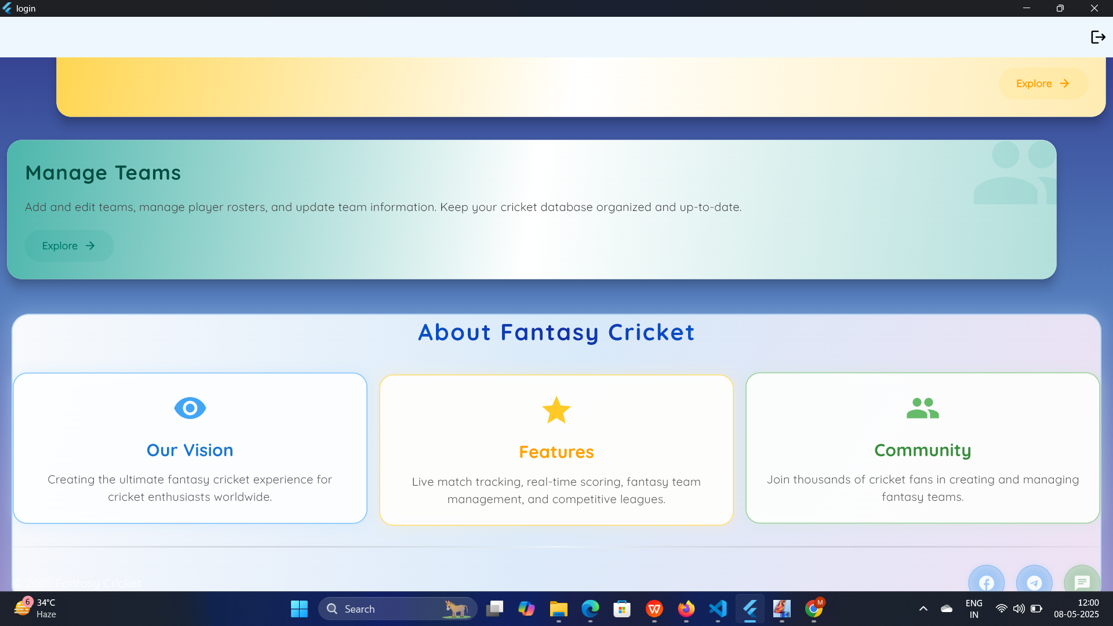
Home Page

Slide 15
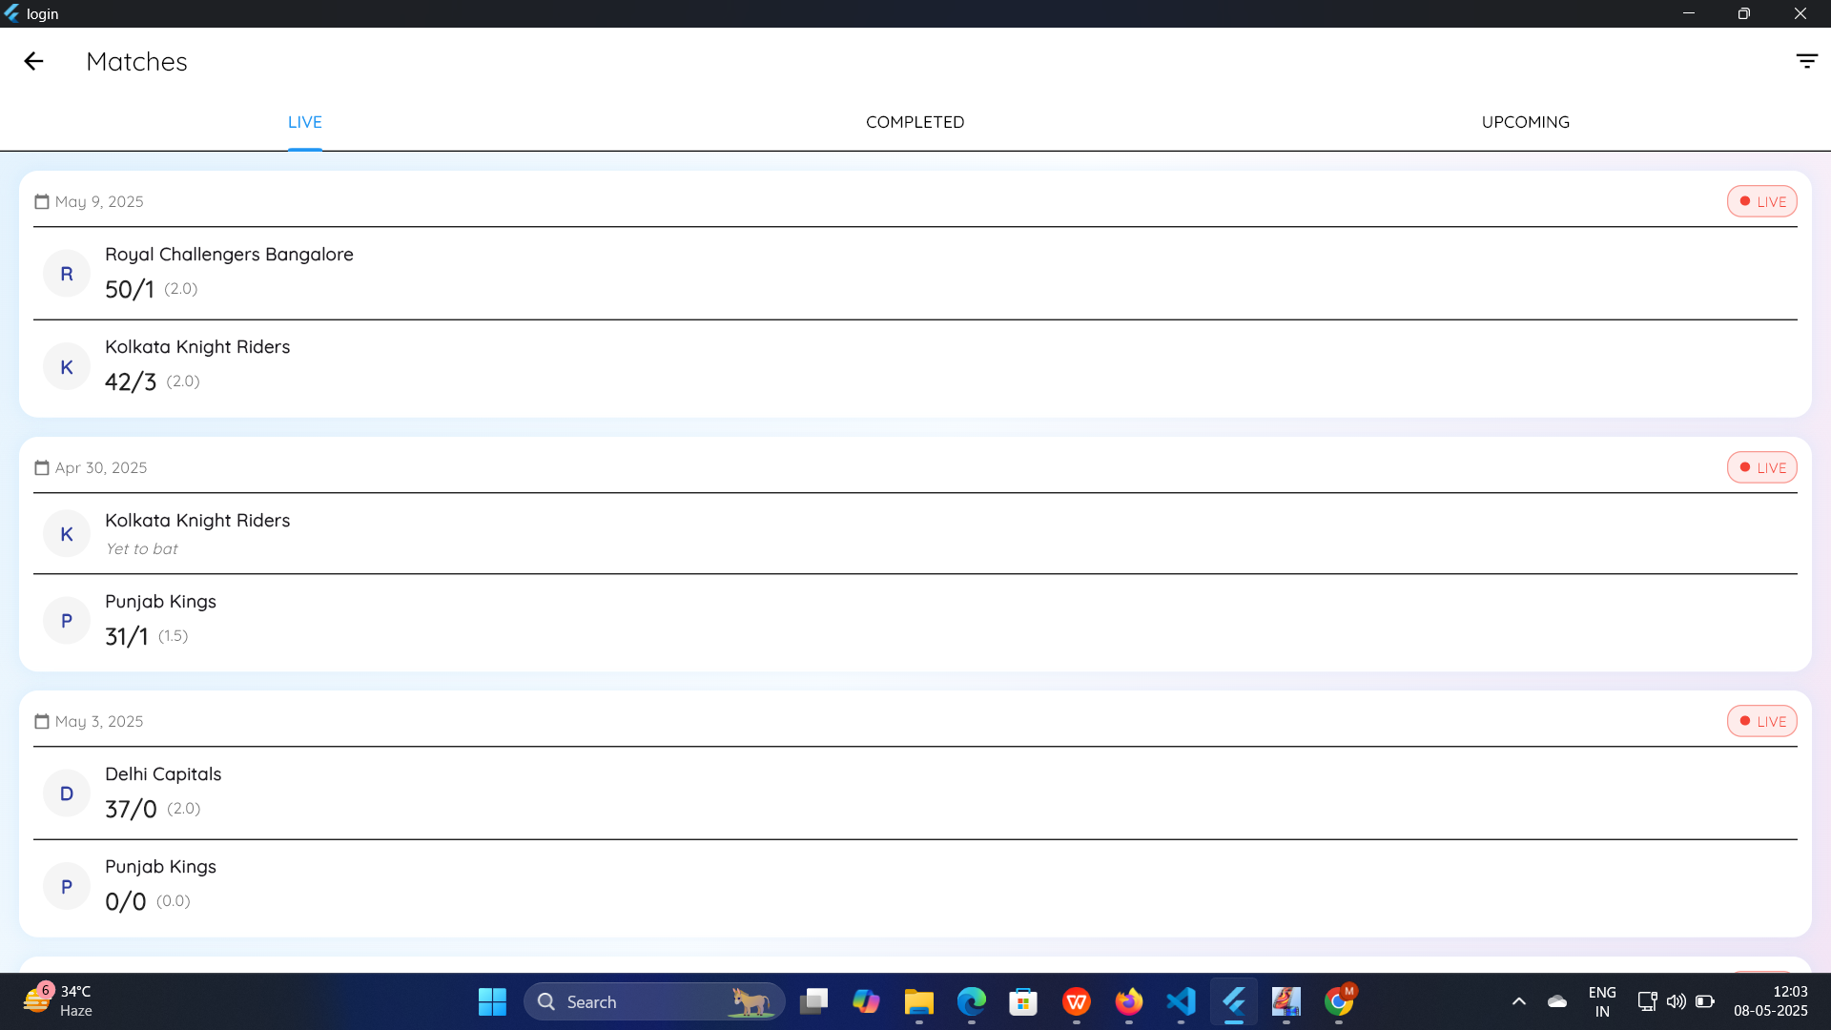
Matches Page

Slide 16
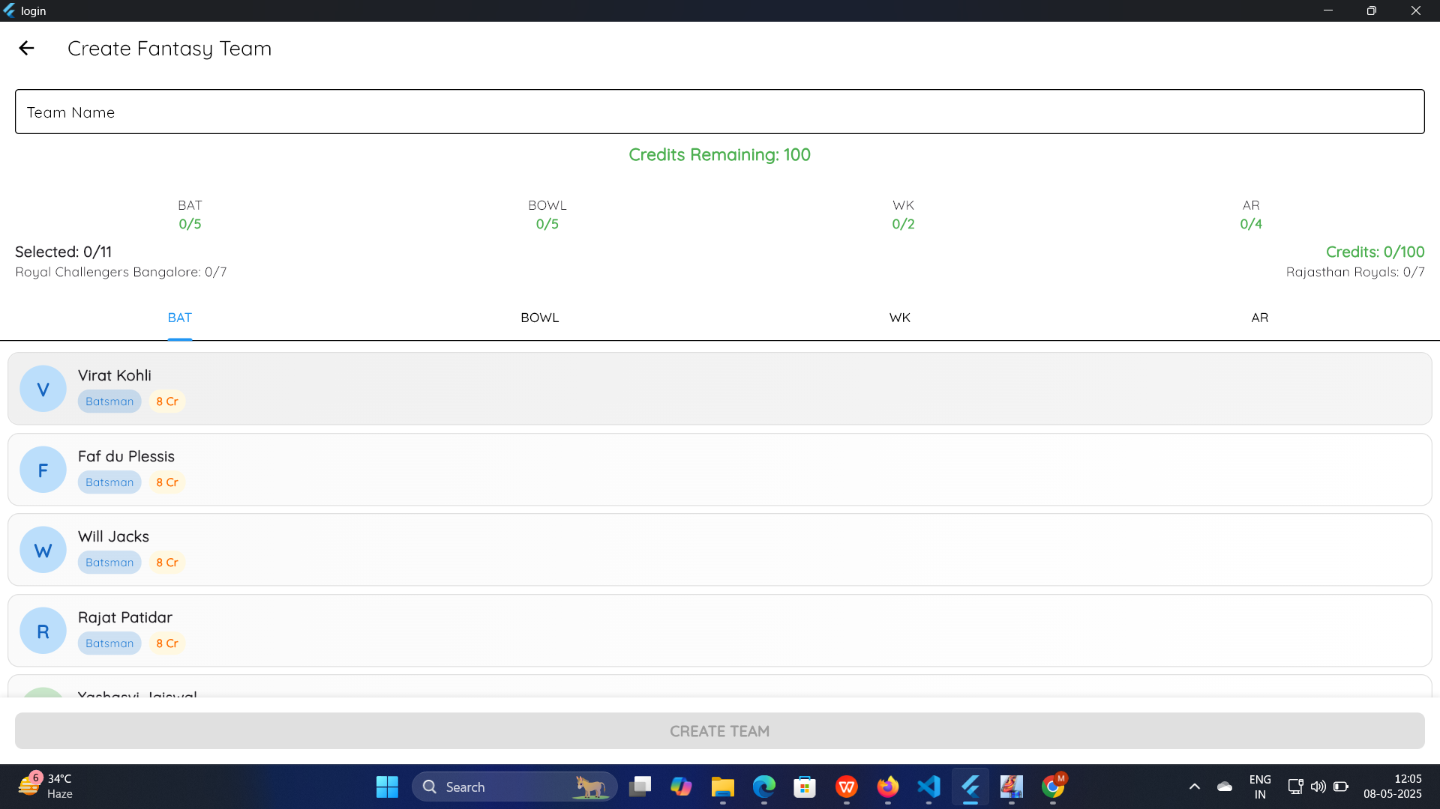
Fantasy 11 Selecting Page

Slide 17
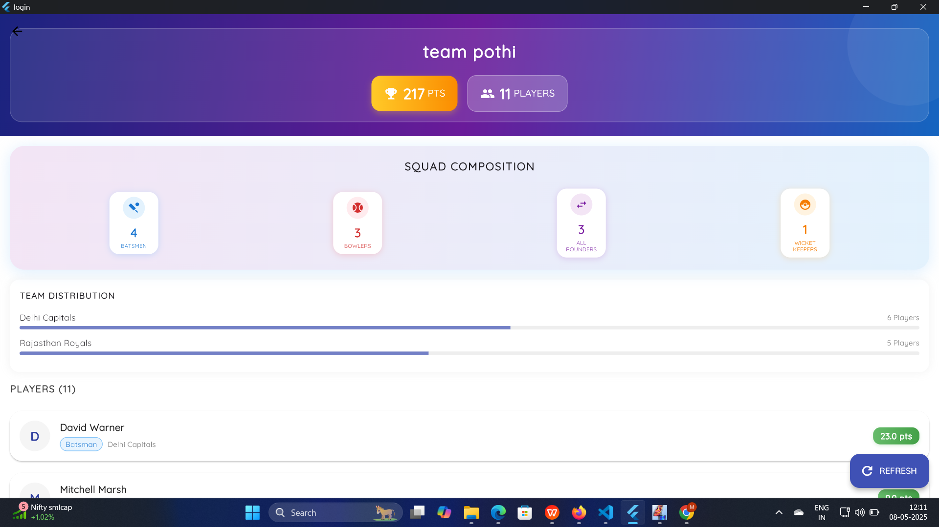
Fantasy Team Page

Slide 18
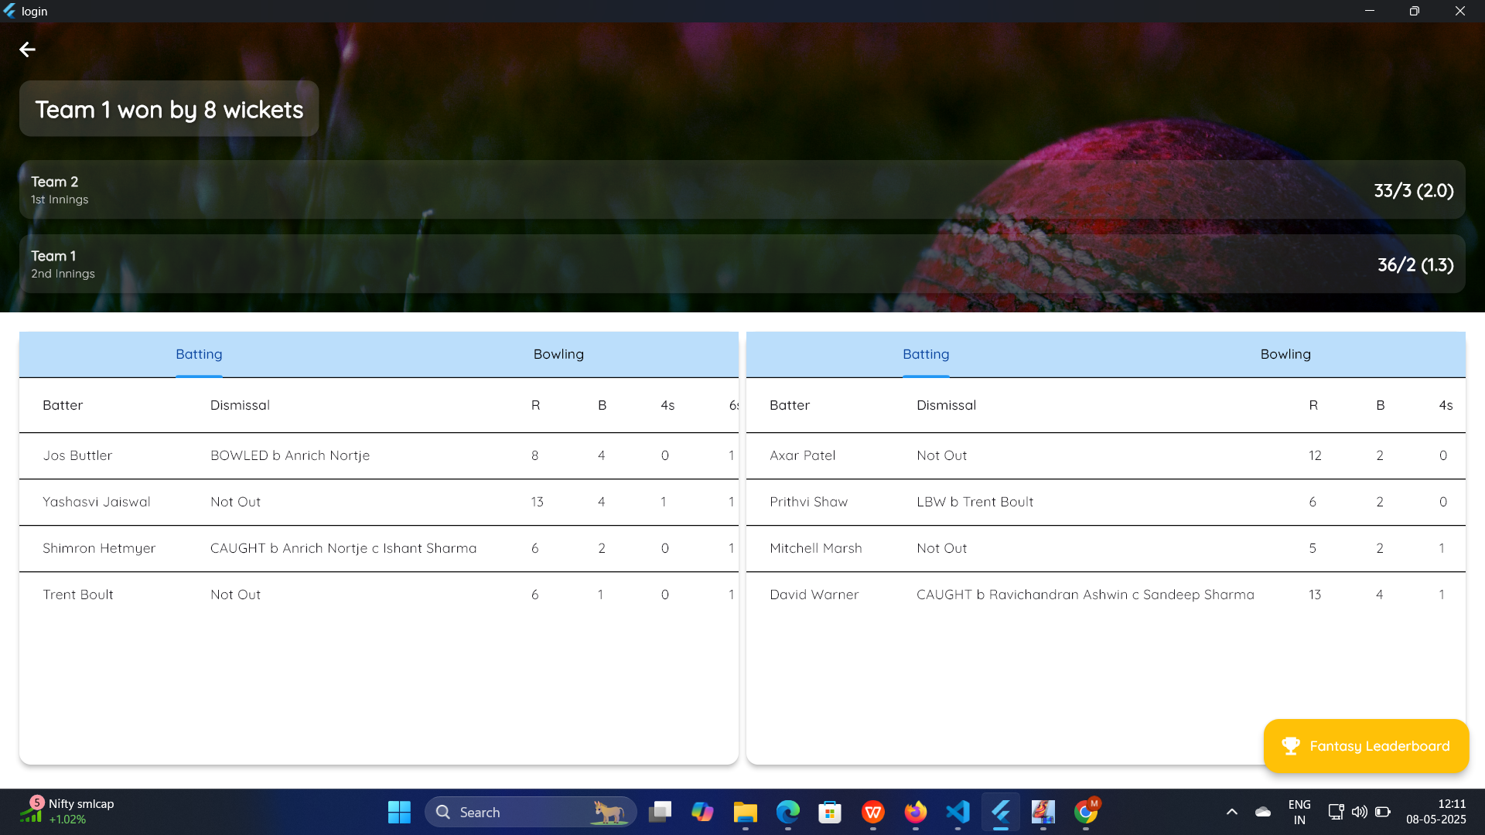
Match Summary Page

Slide 19
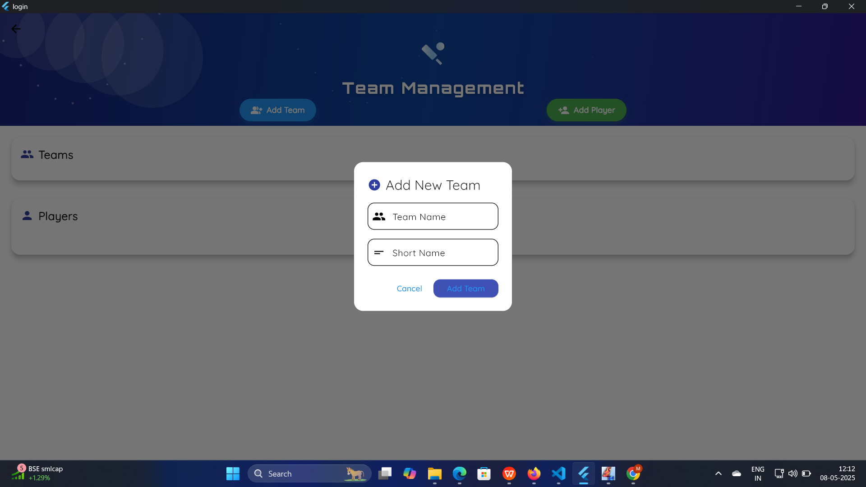
Add new Team Page

Slide 20
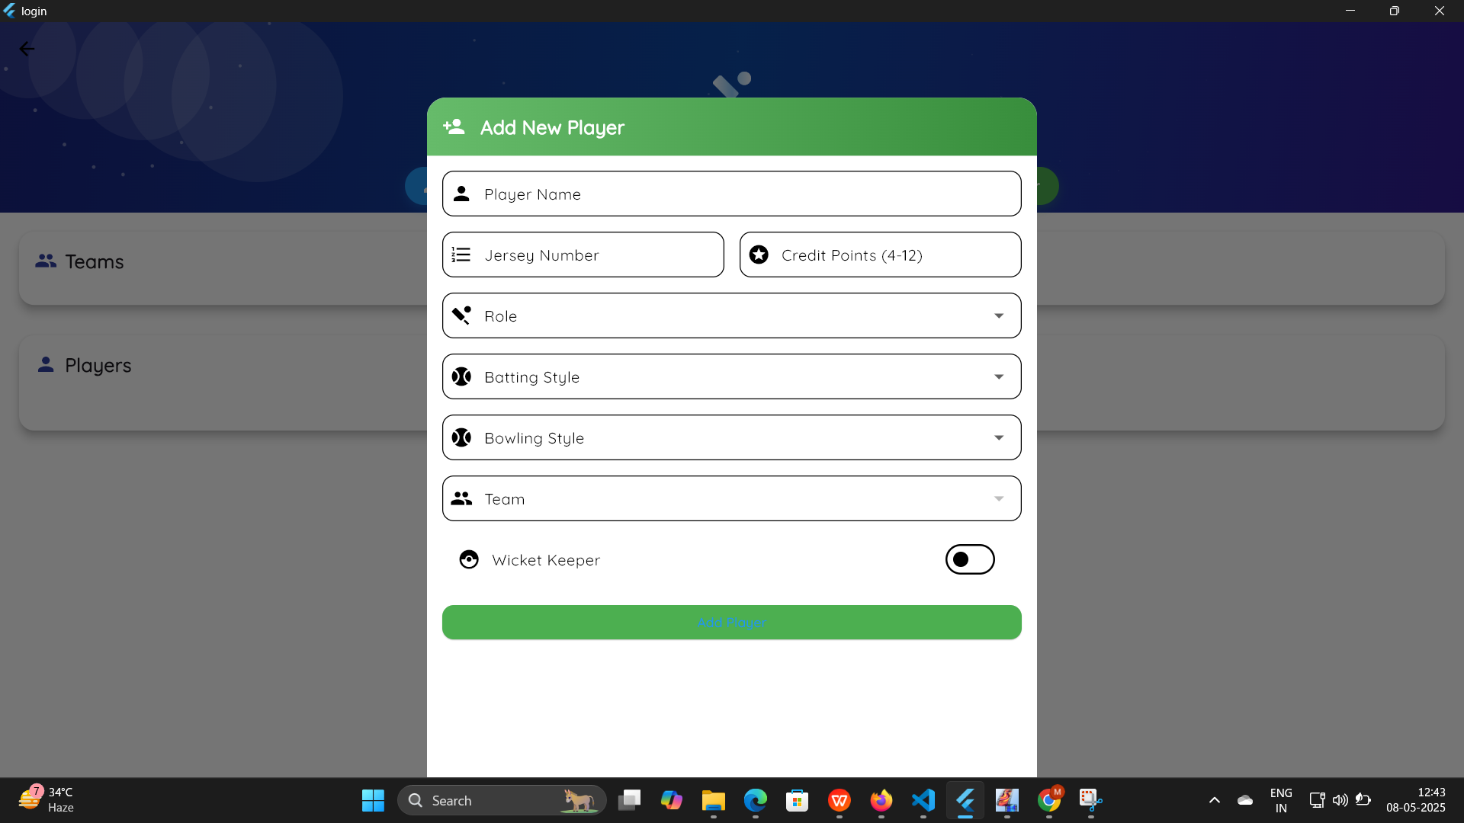
Add Players Widgets

Slide 21
References
1. https://flutter.dev/learn
2. https://www.my11circle.com/how-to-play.html
3. https://supabase.com/docs/guides/getting-started
4. VS Code coding assistant - Model - Claude 3.5
5. Fantasy Concepts Inspired by My11Circle

Slide 22
Demo
Video 1 - Team Management Demo
Video 2 - Complete implementation
Deployed via Github Pages - https://mid2505.github.io/
Source code - https://github.com/mid2505/mid2505.github.io/

Slide 23
Thank You…

